Slide 1
Lab RISC-V to ARM - ALU
CMPUT 229

Slide 2
About this lab
Translate RISC-V Arithmetic Logic Unit (ALU) instructions into ARM ALU instructions.
Control instructions will be translated in the next lab.

Slide 3
What is ARM?
ARM is a RISC architecture.
A Reduced Instruction Set Computer, or RISC (/rɪsk/), is a computer with a small, highly optimized set of instructions, rather than the more specialized set often found in other types of architecture, such as in a complex instruction set computer (CISC).
  From https://en.wikipedia.org/wiki/Reduced_instruction_set_computer
With over 180 billion ARM chips produced, as of 2021, ARM is the most widely used instruction set architecture (ISA) and the ISA produced in the largest quantity.
  From https://en.wikipedia.org/wiki/ARM_architecture

Slide 4
Your tasks in this lab
Create a binary translator that turns a small subset of RISC-V instructions into ARM instructions.
Implement a function to convert RISC-V I-Type instruction immediates into the immediate format required by ARM instructions.
Implement a function for translating RISC-V registers into ARM registers as specified.

Slide 5
ARM Data-Processing Immediate Format
  Bits 27-25 and the OpCode combine to uniquely identify the instruction.
  Rn is the first register operand, similar to the RISC-V source register, and Rd is the destination register.
  The Rotate bits are used with the 8-bit Immediate field in order to obtain a 32-bit immediate.
  The Conditions and S bits aren't relevant until the next lab.
Notes:
bits 27-25 are constant for all instructions of this format, kind of like the RISC-V opcode. here, the opcode changes between instructions of diff types unlike in RISC-V
the mechanism behind immediate and rotate fields is elaborated on later

Slide 6
ARM Data-Processing Register Format
The Shift field is used for shift instructions and allows for certain instructions to be combined with a shift.
Rm is the second register operand, to the RISC-V target register.

Slide 7
Instruction Translation
Input is RISC-V binary terminated by the sentinel word 0xFFFFFFFF.
Each word in the input represents a single RISC-V instruction.
Parse each RISC-V instruction to find out which ARM instruction it should be translated into.
Conver RISC-V registers and immediate fields (if applicable) into an appropriate format.
Combine everything to obtain the translated instruction.

Slide 8
Register Translation
The ARM architecture exposes 16 registers by default, one of which is the PC.
This lab only translates 15 non-PC registers using the following mapping:
t0 (x5) | R0
t1 (x6) | R1
t2 (x7) | R2
s0 (x8) | R3
s1 (x9) | R4
s2 (x18) | R5
s3 (x19) | R6
s4 (x20) | R7
s5 (x21) | R8
s6 (x22) | R9
a0 (x9) | R10
a1 (x10) | R11
a2 (x11) | R12
sp (x2) | R13
ra (x1) | R14

Slide 9
Register Translation
Write a function that translates a RISC-V register into an appropriate ARM register.
  The RISC-V register is denoted by the number following the x in x0, x1, etc.
  The ARM register is denoted by the number following the R.

Slide 10
Immediate Rotation
In RISC-V, there is a single immediate field containing the value of the immediate.
The ARM data-processing immediate format contains two fields of bits that determine the value of the immediate:
  immediate field
  rotation-bit field

Slide 11
Immediate Rotation
The value of the immediate is obtained by shifting the immediate to the right by the value of the rotation field multiplied by 2.
The following is an example of the above process and also appears as a GIF and a PDF in this lab's description.

Slide 12
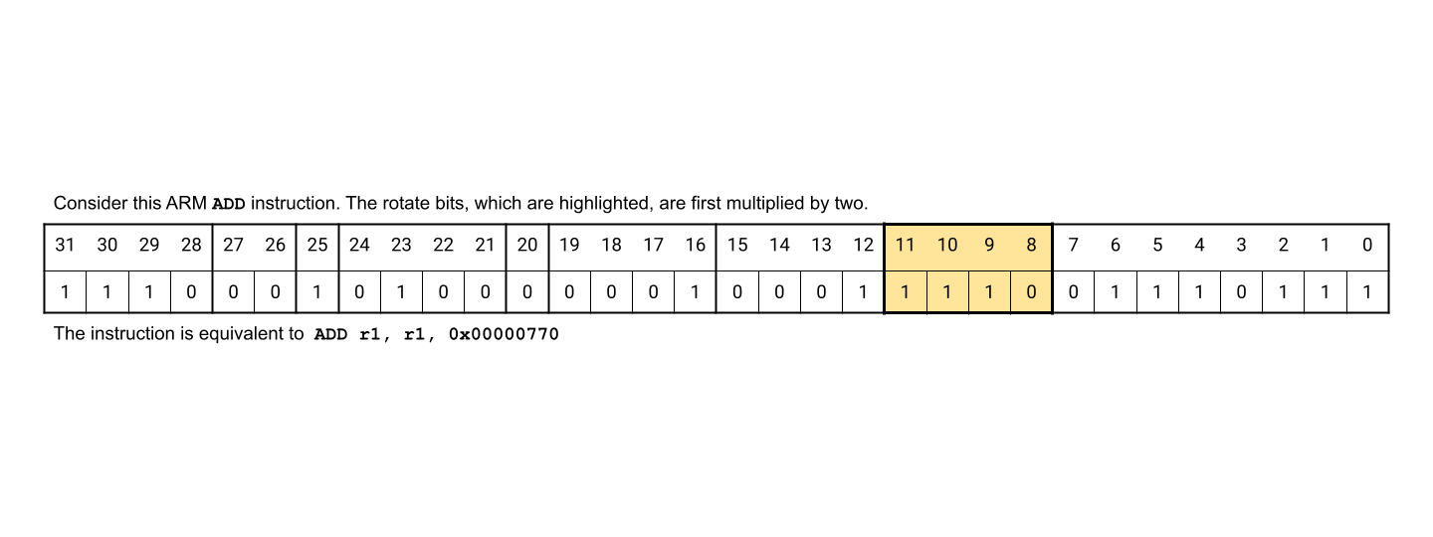
Notes:
the bold vertical borders signify separate fields of the instruction. might be overwhelming but we only care about bits 11-0. the rest are just there for accuracy

Slide 13
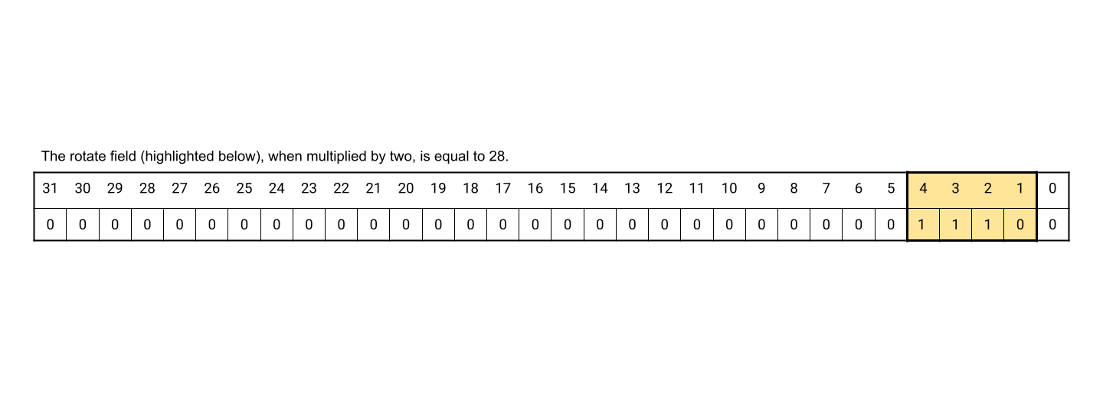

Slide 14
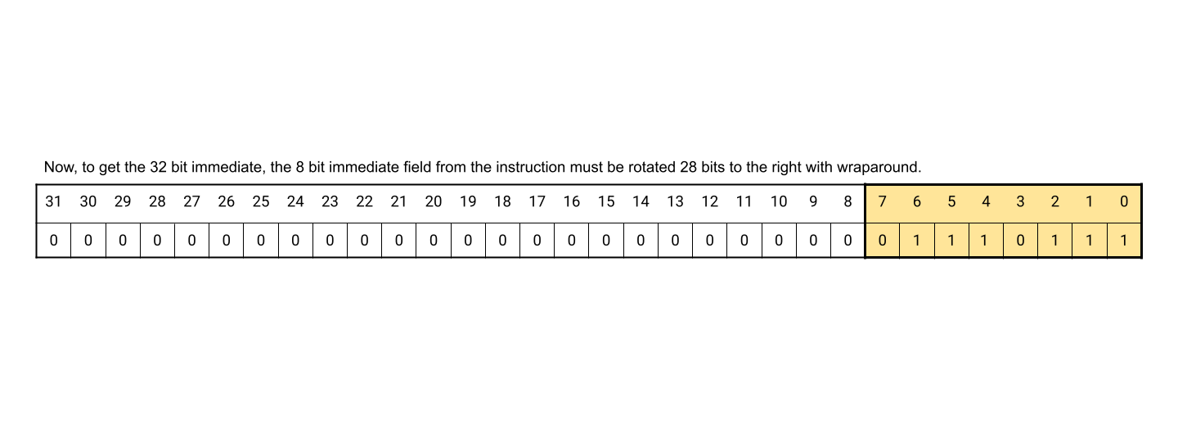

Slide 15


Slide 16
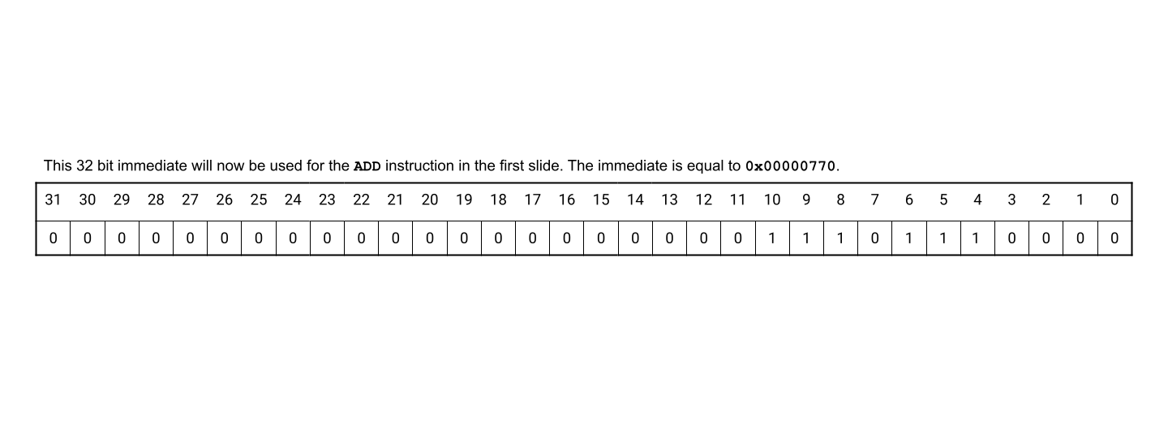

Slide 17
Immediate Rotation
This format does not exist in RISC-V.
Write a function that converts a standard RISC-V immediate into the ARM data-processing immediate format.

Slide 18
Tips
Use the provided test cases.
Create your own tests for various edge cases.
Start with the functions that translate RSIC-V registers and compute ARM rotate and immediate bits from RISC-V immediate fields.
Follow the function's specification.
  These functions are used in the next lab.

Slide 19
University of Alberta Code of Student Behavior
http://www.governance.ualberta.ca/en/CodesofConductandResidenceCommunityStandards/CodeofStudentBehaviour.aspx
30.3.2(1) Plagiarism
No Student shall submit the words, ideas, images or data of another person as the
Student’s own in any academic writing, essay, thesis, project, assignment,
presentation or poster in a course or program of study.
30.3.2(2) Cheating
30.3.2(2) d No Student shall submit in any course or program of study, without the
written approval of the course Instructor, all or a substantial portion of any
academic writing, essay, thesis, research report, project, assignment,
presentation or poster for which credit has previously been obtained by the
Student or which has been or is being submitted by the Student in another
course or program of study in the University or elsewhere

Slide 20
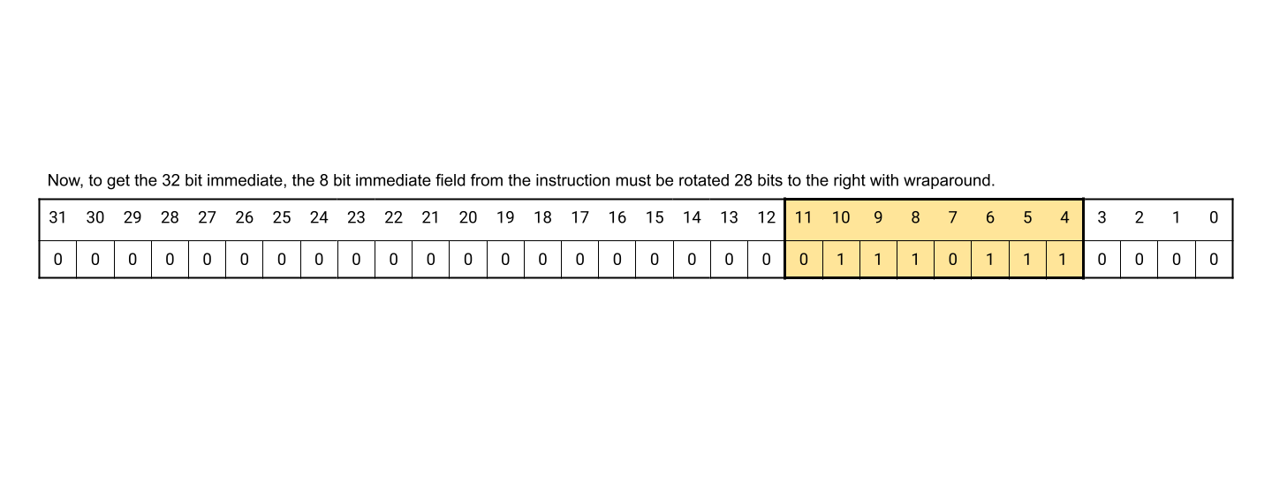
Overview
Notes:
learned about the ARM data formats and most of their fields.
learned about the rotate and immediate fields and how they work in calculating the correct immediate.

